Slide 1
Server-side Web Development
Model View Controller with Servlets and JSP

Slide 2
Servlets – What we know
Servlets are Java programs that run on a Web or App server
They act as a middle layer between the HTTP client and databases or other applications on the HTTP server.
Servlets have access to all Java functionality so they can query Databases.
Servlets can generate HTTP Responses via a PrintWriterobject in the response.
Servlet API is simple.
So what more do we need??

Slide 3
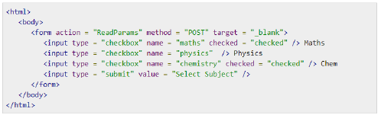

Servlets – Real Example
Simple Form with 3 Checkboxes
Should display something like

Slide 4
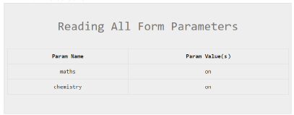
Servlets – Real example Continued
We want a Servlet to process the FORM data and produce something like the following status screen

Slide 5
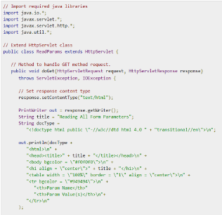
Servlets – Real example Continued
Static Part of HTML output

Slide 6
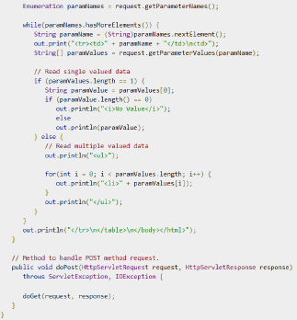
Servlets – Real example continued
Dynamic part of HTML Output
Also Business Logic, validation
edge cases etc.
Static part of HTML Output

Slide 7
Servlets – Real example continued
Lots of stuff going on for relatively simple use case
Business Logic
Data Validation
Static HTML code
Dynamic HTML code
Conditional HTML output
And we haven’t even considered storing choices in a database

Slide 8
MVC - Introduction
Model View Controller is an architectural pattern that helps to structure an application
It helps to support better modularization through a separation of concerns (responsibilities)
Generally leads to easier to maintain code
Most (Java) based Web Frameworks are MVC based frameworks.
Spring
Groovy/Grails
Etc.

Slide 9
MVC – How it’s realised
Splits the application into three logical parts
Models
The central component of the pattern. It is the application's dynamic data structure, independent of the user interface.It directly manages the data, logic and rules of the application.
Views
Any representation of information such as a chart, diagram or table. Multiple views of the same information are possible, such as a bar chart for management and a tabular view for accountants.
Controller
Accepts input and converts it to commands for the models or views.

Slide 10
MVC - Advantages
Simultaneous development –Multiple developers can work simultaneously on the model, controller and views.
High cohesion –MVC enables logical grouping of related actions on a controller together. The views for a specific model are also grouped together.
Loose coupling –The very nature of the MVC framework is such that there is low coupling among models, views or controllers
Ease of modification –Because of the separation of responsibilities, future development or modification is easier
Multiple views –Models can have multiple views
Testability–easy to Unit test the Models and Controllers

Slide 11
MVC - Disadvantages
The disadvantages of MVC can be generally categorized as overhead for incorrectly factored software.
Code navigability–The framework navigation can be complex because it introduces new layers of abstraction and requires users to adapt to the decomposition criteria of MVC.
Multi-artifact consistency–Developers to maintain the consistency across the Model, View and controller.
Excessive boilerplate–Due to the application computation and state being typically clustered into one of the 3 parts, the other parts degenerate into either boilerplate shims orcode-behind[16]that exists only to satisfy the MVC pattern.
Pronounced learning curve–Knowledge on multiple technologies becomes the norm. Developers using MVC need to be skilled in multiple technologies.
Most of the above are minimized due to excellent tooling support.

Slide 12
MVC - Model
This refers to the classes in your application that model the application domain.
What you typically interact with in your application
Examples for a music app might include:
User
Artist
Album
Song
Referred to as domain classes

Slide 13
MVC - Model
The model is responsible for managing the data of the application.
It receives user input from the controller.
Domain objects will typically need to be persisted to the database.
Often this is a relational database like MySQL.
If there is an Object Relational Mapping (ORM) used (e.g. Grails) there will be no need to write SQL code.

Slide 14
MVC - Views
The view means presentation of the model in a particular format.
Often called the presentation layer, it’s what the user sees in your application.
Views will normally need to access domain objects in order to provide information to the client.
These domain objects are made available to the views by the controller.

Slide 15
MVC - Views
In the context of a Web Application
These are what generate the HTML pages that are sent back to the user.
Views are usually written as JavaServerPages (JSPs).
JSP has its own tags (JSTL) which are translated to HTML at run time.

Slide 16
MVC Controller
The controller responds to the user input from the views and performs interactions on the data model objects.
The controller receives the input, optionally validates it and then passes the input to the model.
It is also responsible for making the domain objects (models) available to the Views

Slide 17
MVC Controller
In the context of a Web Application
The controller is what accepts the HTTP request and decides what to do with it.
For example it might
create a domain object
persist it to the database
choose the view to be rendered to the user

Slide 18
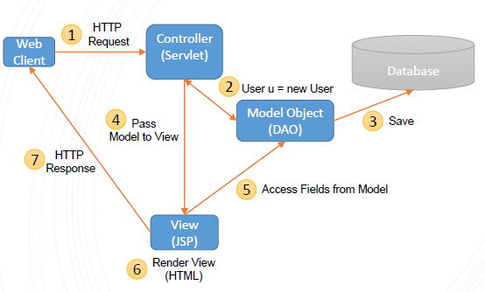
MVC – Architecture Example Create

Slide 19
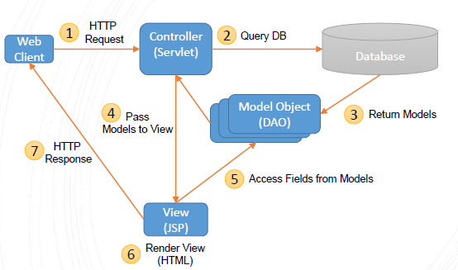
MVC – Architecture Example Retrieve

Slide 20
Servlets - Packages
Java Servlets are Java classes run by a web server that has an interpreter that supports the Java Servlet spec.
Servlets can be created using classes and interfaces from the javax.servlet andjavax.servlet.http packages, which are a standard part of the Java’s Enterprise Edition
These classes implement the Java Servlet and JSP specifications.
Java servlets have been created and compiled just like any other Java class. As long as the libraries are on your CLASSPATH, you can compile servlets with the JDK's Java compiler or any other current compiler.

Slide 21
MVC – Worked Example
Simple MVC application with:
1.User.java –domain class (model)
2.index.jsp–start page,including Form (view)
3.ShowUser.jsp(view)
4.HelloControllerServlet.java (controller)

Slide 22
MVC – Model (User.java)
Simple Model/Domain Class
User.java with attributes
String name
String address
Constructor
Getter and Setter methods
Fields with public getter and setter methods are known as properties.
This type of class is also known as a JavaBean

Slide 23
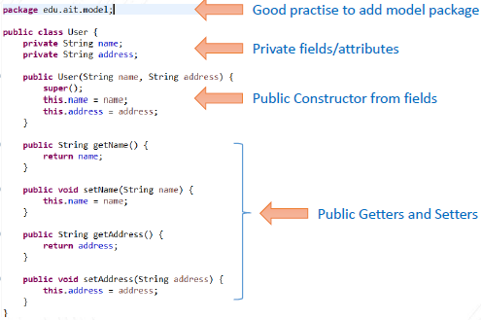
MVC – Model (User.java)

Slide 24
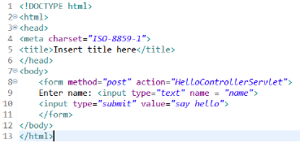
MVC – View 1 (index.jsp)
Standard HTML with FORM packaged as JSP
No JSP specific code needed
Simply asks for Name and sends to HelloControllerServlet via POST when submitted

Slide 25
MVC – View 2 (ShowUser.jsp)
Uses the JSP Standard Tag Library (JSTL)
More specifically it only uses the core tags
[<%@ tagliburi="http://java.sun.com/jsp/jstl/core" prefix="c" %>]
To reference these tags it uses the c prefix
References the User (model) properties using the notation ${user.name} and ${user.address}
Prints out the name and address using the out tag in the JSP core library.
<c:out value="${user.name}"/>

Slide 26
MVC – JSP Taglib directive
The taglibdirective needed is
<%@ taglib uri="http://java.sun.com/jsp/jstl/core" prefix="c"%>
Put this on the first line in your JSP files.
This declares that your JSP file uses a certain set of custom tags.
[It is not necessary to put it into the index.jsp file.] as we are not using any JSTL tags, just standard HTML

Slide 27
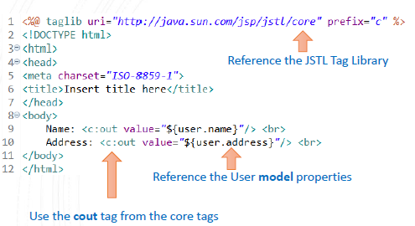
MVC – View 2 (ShowUser.jsp)

Slide 28
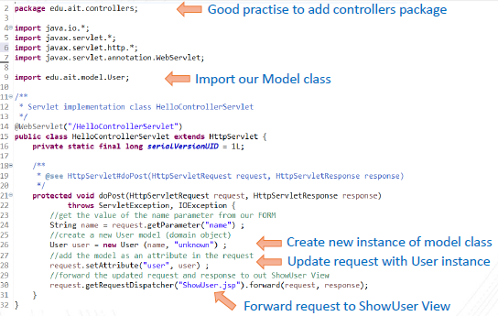
MVC – Controller (HelloControllerServlet)

Slide 29
JSTL – JSP Standard Template Library
JSP Standard Template Library. https://github.com/eclipse-ee4j/jstl-api/releases
Two JAR files
1.javax.servlet.jsp.jstl-1.2.1.jar
2.javax.servlet.jsp.jstl-api-1.2.1.jar
Five libraries
1.core,
2.formatting,
3.SQL,
4.XML,
5.Functions
We use the core library.

Slide 30
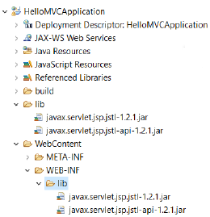
JSTL – Setup and Configuration
Create a Dynamic Web Project.
Create a new lib folder
Copy the two JSTL jars into the new folder lib
WebContent\WEB-INF\lib

Slide 31
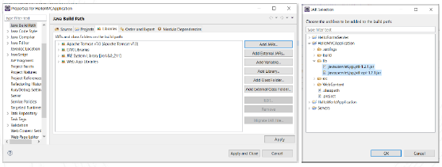
JSTL – Setup and Configuration
Set up the Build Path.
Right Click -> Build path -> Configure Build Path
Under libraries tab -> Add Jars, expand your web app and shift-select the two jars in lib folder

Slide 32
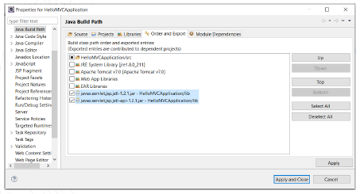
JSTL – Setup and Configuration
Set up the Build Path.
Under Order and Export tab select the checkboxes for the two jars, then Apply and Close

Slide 33
JSTL – Setup and Configuration
Putting the JAR files on the Build Path makes sure they are available at build (compile) time.
Putting them into the lib folder in WebContent makes them available at run time.

Slide 34
MVC – Running Example
Right click on index.jsp -> Run on Server
Enter name and click say hello
Form action sends POST to HelloControllerServlet (notice new URL)
HelloControllerServlet creates User object and forwards to ShowUser.jsp (URL doesn’t change)
If we used redirect instead of forward it would be reflected in a new URL

